Slide 1

PowerPoint for everyone
General Office Policy
July 2026
​ Your introduction to our PowerPoint template
July 2025 | v 0.10

Slide 2
Policies and Procedures
Responsibility of every employee of PwC Kazakhstan is to read and comply to Policies and Procedures established in the Firm
You can find them on PwC Portal: Policies and Procedures

Slide 3
Clean desk policy
Keep your desk clean and tidy at ALL TIMES!
Keep your laptop locked AT ALL times
Lock computer and documents in your locker before leaving home
Leave the desk CLEAN
Do not bring food to your working desk
All paper garbage shall be put into the grey TRASH BOX
Lock computer, files and documents before leaving the office!

Slide 4
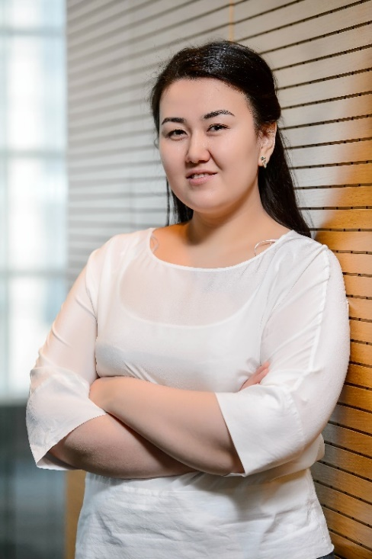
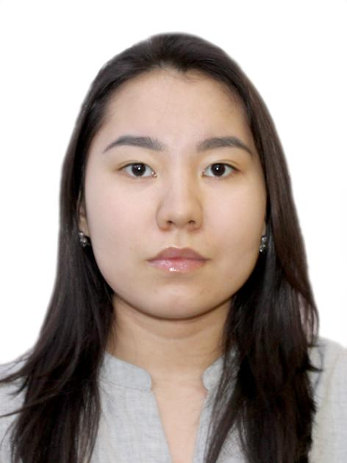
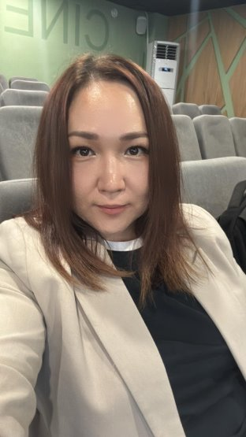
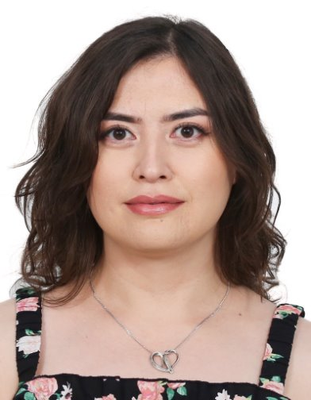
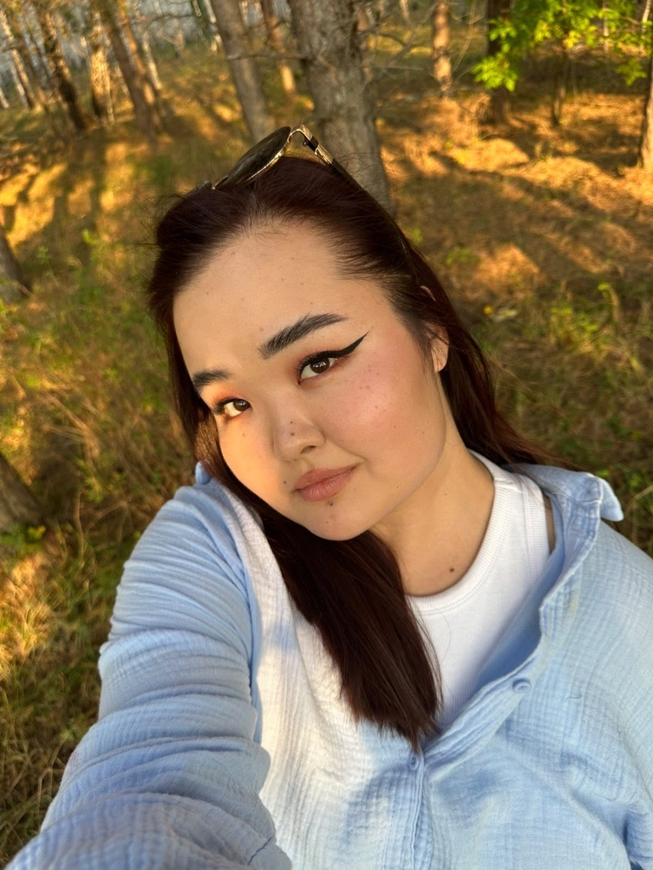
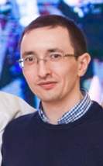
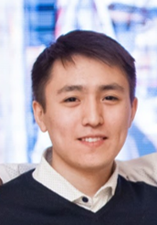
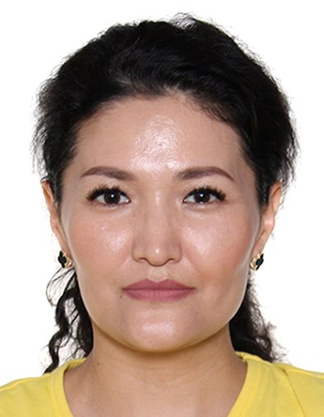
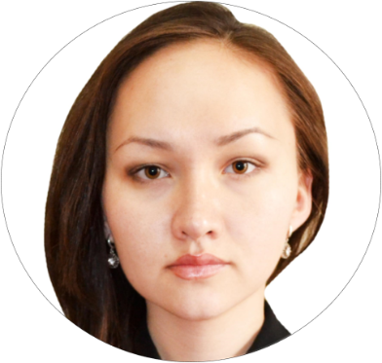
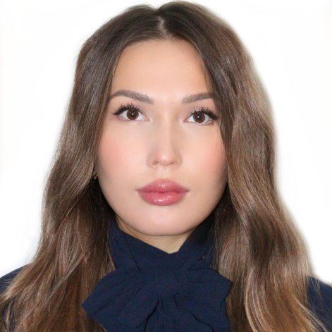
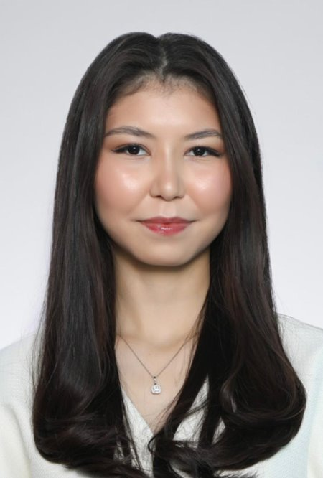
Astana Infrastructure and Procurement Team
Saltanat Orazaliyeva
I&P Manager
mob: +7 701 711 91 65
H&S, Procedures, agreements, contractors, office administration, invoice review, events support, security issues Business continuity, coffee lady and drivers coordinating
Alina Zhetes Coffee-lady
Event support, canteen stationary control
Damira Telzhanova
Office manager
mob:+ 7 778 713 52 12
Ipos and SDM coordinator, office maintenance, procurement, event support, envelopes, stationary control
Gulbagit Nurzhanova Zhanar Tashenova Receptionist Receptionist
Postal distribution, incoming calls, express mailing, business cards, coordinationg office transport services (drivers, taxi, Yandex)
Astana IT Team
Administrative Assistants
Yerlan Akpanov
IT Business Partner
mob: +7 701 971 37 86
Yerbol Sultan
Senior Specialist
mob: +7 707 687 81 87
Ainur Iskakbayeva
Assurance
mob: +7 701 703 31 59
Zhansaya Ibragimova
Assurance
mob: +7 777 906 3428​
Assel Shakhmanova
TLP
mob: +7 701 012 06 06
Aigerim Zhomartkyzy
TLP
mob: +7 702 828 48 39​

Slide 5
ID badges
ID badge request: Reception
While waiting for your personal PwC pass card, you can get a one-day guest card provided by PwC Reception. Don’t forget to return after work.
Use your personal PwC pass card to entry to the building and office.
It is prohibited to hand over the personal key access pass to ANY person.
ONLY YOU bring responsibility for your ID badge!
In case of lost PwC pass card please inform IT Specialists or Admins to block them immediately!
Create a request in ServiceNow.
Penalty KZT 2 900
Expecting a visitor?
Inform PwC Reception and Admins at least 1 day in advance writing visitor’s name/company/arrival time.
Access to working areas and Canteen for visitors is prohibited.

Slide 6
Security measures
Please be very vigilant of your belongings!
Keep ALL your personal belongings locked, NEVER leave them unattended
Taking a laptop with you NEVER leave it unattended anywhere including your or provided driver's car
When a theft occurs:
during office hours-> call Admin office first
Out of office hours –> call police as soon as possible and receive a proper police report
Report any incident IMMEDIATELY to IT, HC and Admin so we can take appropriate action.

Slide 7
Business cards
All business cards orders are placed once a month and all requests are to be submitted to Reception by the 20th day of the month
Please fill in the BC order form at SharePoint (KZ Marketing) and send it to Reception
Business cards will be ready in 5 working days after the order placement
Please provide charge code and make sure that all details for business card are correct

Slide 8
Office supplies
Standard daily stock is available in Printing Rooms (pens, pencils, files, etc.)
Special/ large procurement order will be processed in 7 working after it’s placement
All URGENT orders are the subject to Partner’s Approval

Slide 9
Office maintenance
Spotted bulb went off?
Anything broken?
Please let Admin/Reception know so we put things in order immediately or soonest possible
Office temperature is set to the lowest temperature
Please take the warm clothes if you do not like cold
Admin thanks you in advance for assisting us to maintain the office in proper condition!

Slide 10
Internal Post and Deliveries
Regular posting between PwC offices: Almaty, Astana and Atyrau is every Thursday by 15-00
Posting to the Clients and Suppliers and urgent PwC is daily by 16-00
Documents in the closed envelope should be provided and registered at Reception by 16:00. Reception team will arrange a dispatch.
Post Delivery Request shall be created in ServiceNow.
The envelope shall be sealed with indication of Addressee name and company, telephone # and Addresser name.
Delivery within Astana city is arranged ONLY by drivers
International and other deliveries are arranged by DHL
Delivery to Russia and Belarus are arranged by Asia Sky Express

Slide 11
Working desk hoteling
All Staff does not have fixed desks, except Partners
Please use Mapiq Booking system
Follow the “Clean Desk” Policy
7 shifts each week
You can plan 3 days in advance
Any day of the week
Cancel booking if you are not in the office

Slide 12
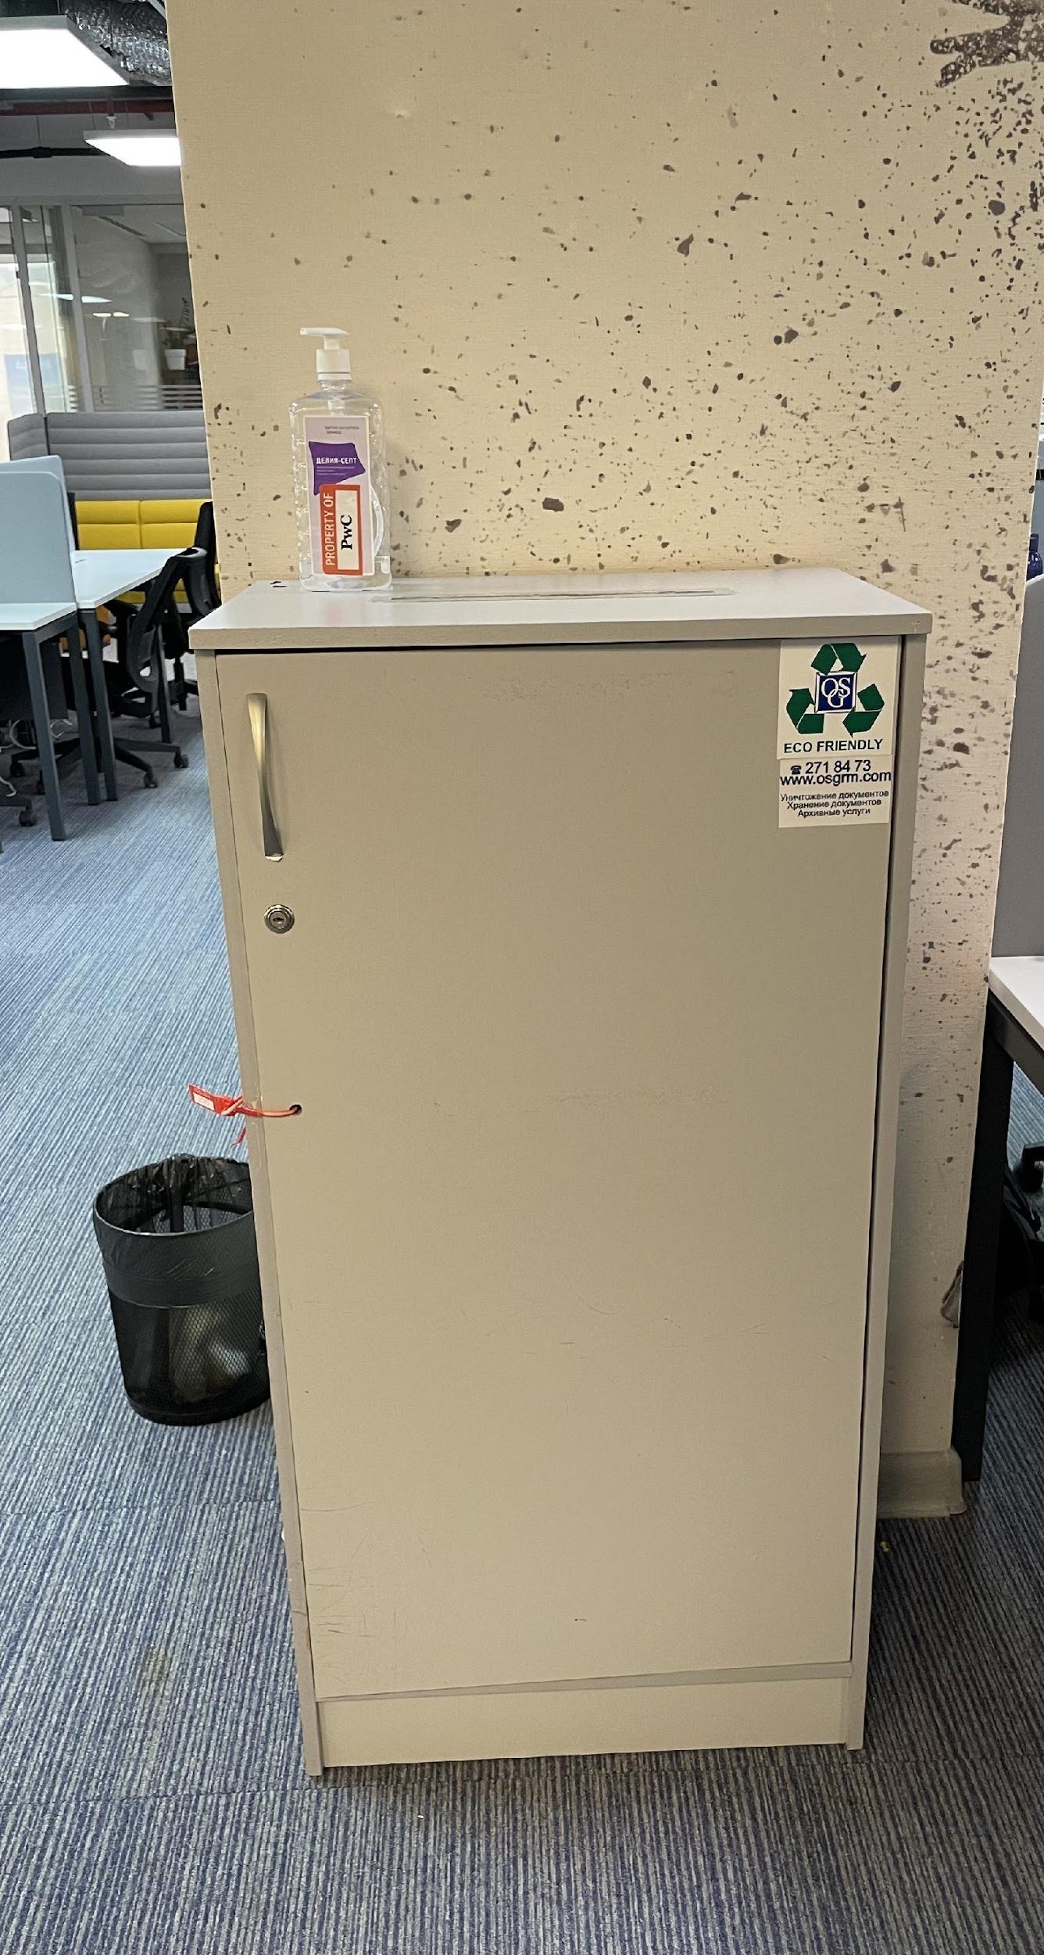
Shredding/Shredder bin
Deposit confidential documentation into the large grey boxes (Shredder Bins) located around the office
The Firm pays money for each kilo of shredding paper
Make sure there are No paper clips (скрепки) or plastic covers
DO Not deposit any magazines or brochures into the Confidential Bins

Slide 13
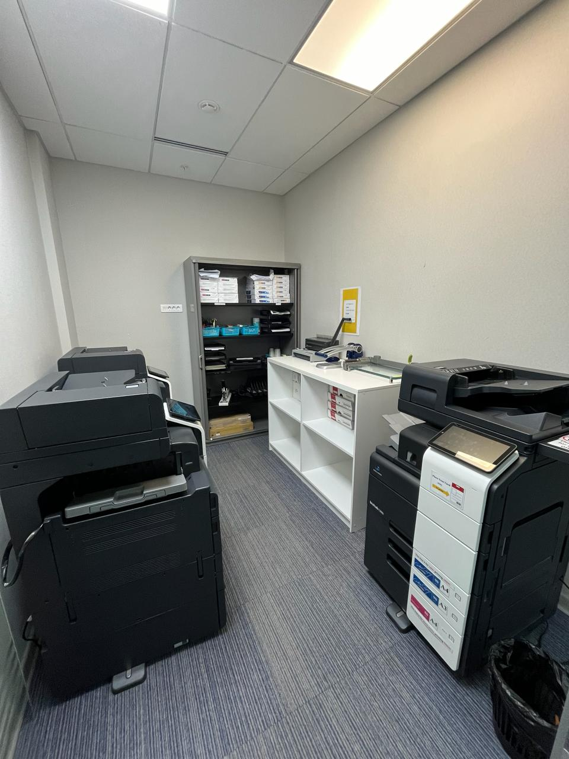
Printings and papers
Try to avoid printing of hard copies wherever possible
Black/ white printing is set-up by default
Colour Printing is for Client reports only
Do NOT use Binding machine paper for printing!
Read Instructions before using the Binding machine

Slide 14
Canteen
Please enjoy your breakfast, lunch and afternoon snack in the Canteen
Service is available: 8.30 AM – 5.00 PM
from Monday to Friday
Ground Rules:
First come -> first sit, NO bookings
Coffee is not served from 1 PM to 2 PM during lunch time
Please show courtesy to our caterer and bring cups and mugs back to the PwC Club
Use Food Trash Bins for any food garbage
Private Events in Canteen
Private celebrations are allowed from 10 am to 11 am and from 4 pm to 5 pm
The organizer is responsible to arrange cleaning of the tables
Take away garbage from the office to the trash bins located in the underground parking. (Please contact the on duty cleaning lady, she will accompany you).
Do not leave the garbage on the tables or on the bar!

Slide 15
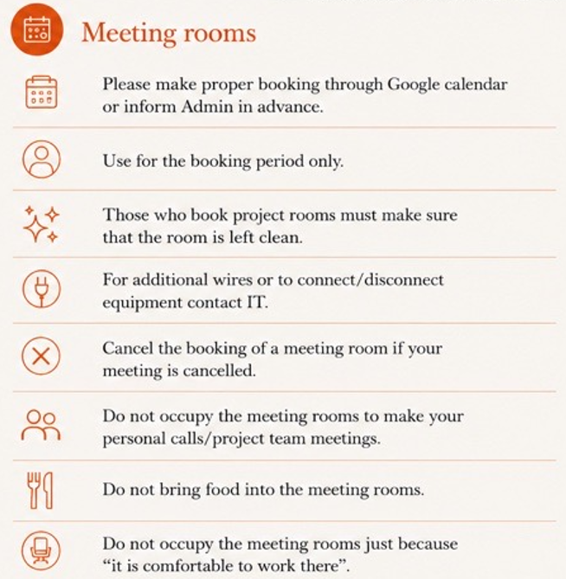
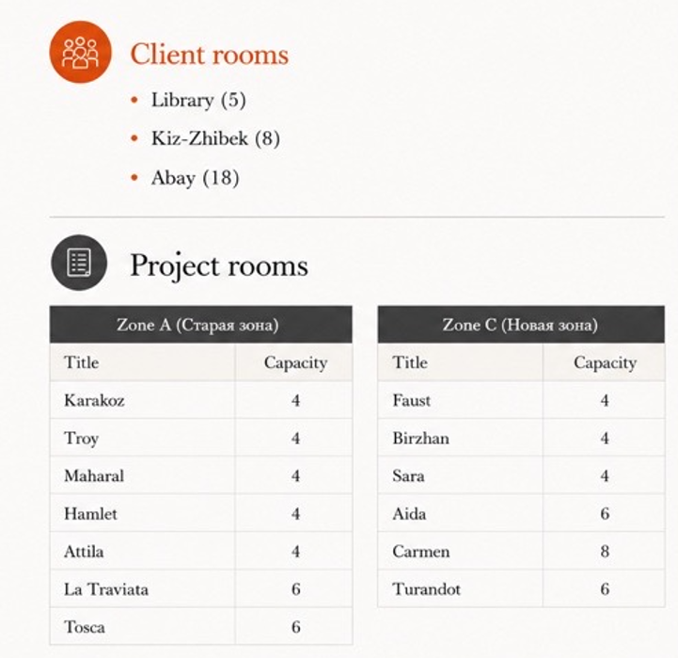
Client and Project rooms

Slide 16
Office Transportation
Office transportation is provided only for business purposes from/ to the office
Book office car through Car Request in ServiceNow at least in 1 hour
Input the correct Client code- it is important!
If PwC cars are busy Reception will order Astana taxi with corporate tariff. The cost will be charged to PwC
Out of working hours use a taxi, pay in CASH and report
Requests are not processed out of business hours and on weekends

Slide 17
Arranging airport transfer
Create a Car Request through ServiceNow
Attach e-copy of your air ticket
Input the correct Client code
Indicate time of flight departure/arrival
Reception will send you information about time of pick up, driver’s name and his mobile phone #
Waiting time is 10 minutes

Slide 18
Transportation during business trip
In accordance with PwC Expense Report policy per diems cover meals, taxi (except Airport transfer) and other incidental expenses
Airport transfer
Trip to/ from Airport is covered by the Firm
Outside of city of residence you shall pay for taxi in cash and get reimbursement through standard Expense reports
Visitors from outside of Kazakhstan pay for airport transfer in Cash
All taxi costs of Astana staff in Almaty, Atyrau and vice versa will be charged to personal accounts.
Sometimes Almaty/Astana/ Atyrau trip might require substantial taxi/travel costs (several meetings in different parts of the city on the same day).
In such cases staff could claim actual costs supported by receipts upon Partner's approval

Slide 19
Parking
ВС «Q2» underground parking is available for 14 parking lots (KZT 70 000 incl. VAT per month or KZT 35 000 per month 08:00-20:00).
To apply for a parking place please contact Saltanat Orazaliyeva.
ВС «Q2» surface parking is available for PwC employee and guests upon submission of PwC ID cards.
Please note that parking places for Q2 tenants are on first come-first serve basis.
If you are waiting visitors please inform our Reception desk about the number & model of car for passing to surface parking.
Parking Astana Opera 10 000 kzt per month (+16% VAT)

Slide 20
Non-smoking office
Any types of cigarettes are prohibited in the office (including WC)
There are special Smoking areas around the BC: the back yard and the front yard
Do not bring cigarette butts to the office

Slide 21
Discounts for PwC staff
Roastbeef restaurant 10%
Wall Street Astana restaurant 15%
Cvetasto flower shop 10%

